Slide 1
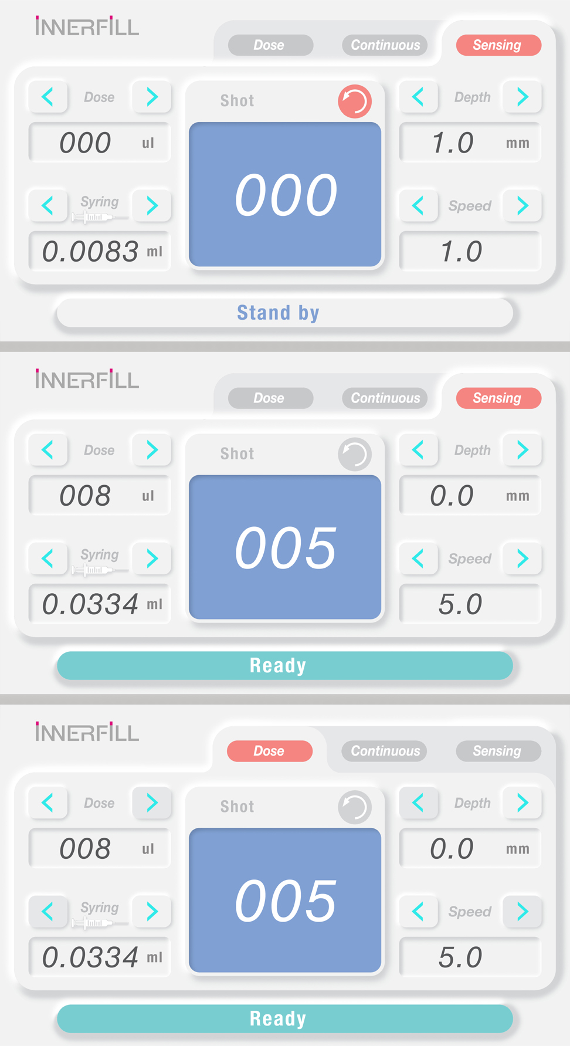


Slide 2



Active Mode
Power
Passive Mode

Slide 3
Active Mode
Power
Passive Mode
Strength Check

Slide 4





Active Mode
Speed
0.
Repeat
Time.
Angle
Torque
EMERGENCY STOP

Slide 5
Active Mode
STOP
Speed
0.
Repeat
Time.
Angle
Delay

Slide 6


Passive Mode
Torque
0.
LoadValue
Time.
JogValue
EMERGENCY STOP

Slide 7
Passive Mode
STOP
Torque
0.
Support Mode
LoadValue
Time.
Resistance Mode
JogValue
Proportional Mode
EMERGENCY STOP

Slide 8
Passive Mode
Torque
LoadValue
Time.
JogValue
EMERGENCY STOP

Slide 9





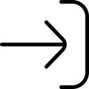



Slide 10


